Slide 1
JavaJam
William Gay
Notes:
http://omega.uta.edu/~wag9927/Gay-Website2/JJHome.html

Slide 2
Why does my website work?
“a web presence for his shop that will display his services and provide a calendar for the performances. Would like:
Home Page,
Menu Page,
Music performance schedule Page
Job Opportunities Page.”

Slide 3
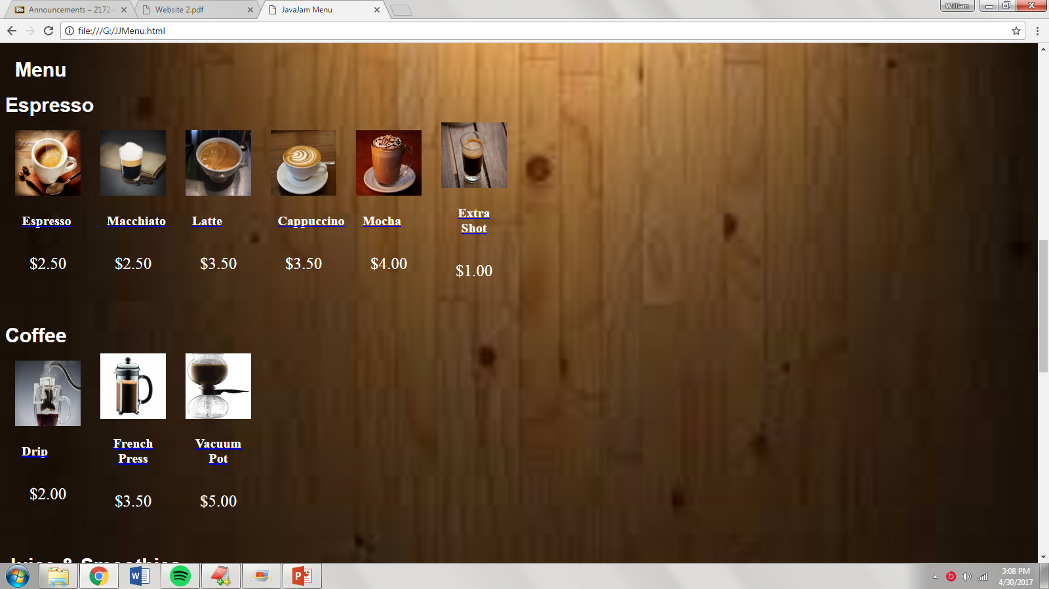
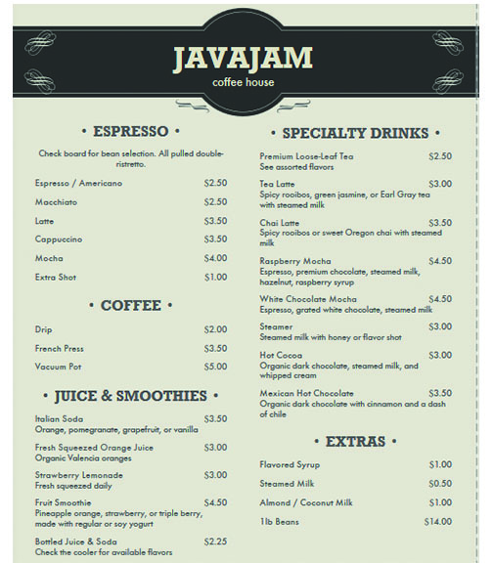
Features

Slide 4
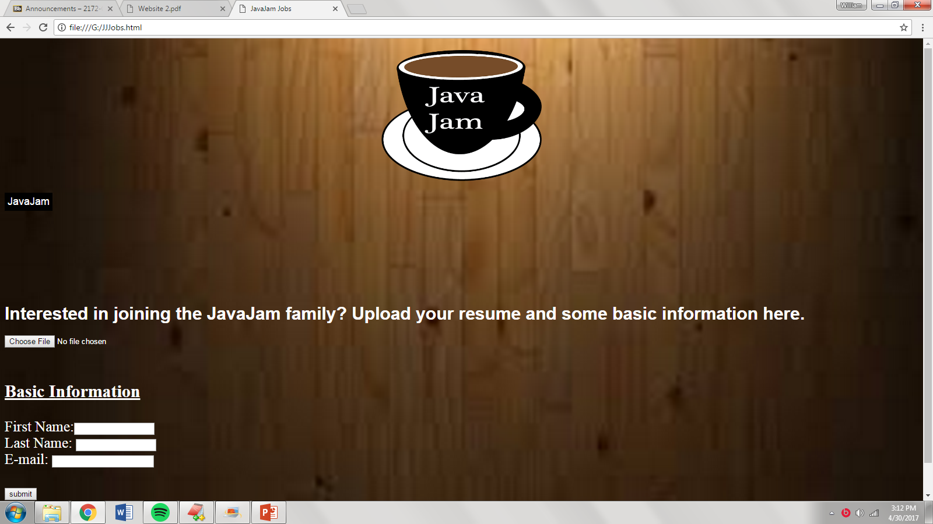
Features
Upload Resume JavaScript
<script>
function myFunction() {
var x = document.getElementById("myFile");
x.disabled = true;
}
</script>

Slide 5
Why buy my JavaJam site?
Great look.
Works well on all technology.
Provides all requirements that Julio Perez is looking for.

Slide 6
Thank You
Bye!!

